Slide 1


Security Headers Analyzer
Lekkasha prasad S.R

Slide 2
Introduction to Security Headers Analyzer
The Security Headers Analyzer is a web-based tool designed to assess the security posture of websites by analyzing their HTTP response headers.
Objective:
Analyze and store security headers of a website to assess its security posture.
Understand the impact of the Security Headers Analyzer on website security practices.
Technologies: HTML, CSS, PHP, cURL, and MySQL.

Slide 3
User Interface Overview:- HTML and CSS: Simple form for URL input. Form Design: Text input for URL and submit button. PHP Backend Overview:- Form Handling: Processes URL input on form submission. cURL for Header Fetching: Uses PHP's cURL library to fetch headers. Analyzing Security Headers with cURL:- cURL Options: CURLOPT_URL, CURLOPT_RETURNTRANSFER, CURLOPT_HEADER. Header Parsing: Identifies security-related headers.

Slide 4
Database Integration and Data Insertion
Database Connection:-
Establishes a connection to a MySQL database using PHP's MySQLi. This step is crucial for interacting with the database.
SQL Query Preparation:-
Constructs an SQL INSERT INTO statement to add new records to a table. This statement specifies the table and the columns where the data will be inserted.
Data Insertion:-
Executes the SQL query to insert the analyzed security headers into the database. This involves converting the collected headers into a format suitable for the database and ensuring that the data is correctly mapped to the table's columns.

Slide 5
Analysis Process
User Input:-
Users input the URL of the website they want to analyze into the Security Headers Analyzer tool.
This URL serves as the target for fetching HTTP response headers.
Header Retrieval:-
The Security Headers Analyzer utilizes the cURL library to initiate a request to the specified URL.
This request retrieves the HTTP response headers sent by the web server in response to the request.

Slide 6
Parsing and Analysis:- Upon receiving the HTTP response headers, the Security Headers Analyzer parses the headers to extract relevant security-related information. It identifies various security headers present in the response, such as Content Security Policy (CSP), Strict-Transport-Security (HSTS), Cross-Origin Resource Sharing (CORS), and more. The tool then analyzes each security header to determine its configuration and adherence to security best practices. Presentation of Results:- Finally, the Security Headers Analyzer presents the analysis results to the user in a clear and understandable format. This presentation of results enables users to gain insights into the security posture of the analyzed website and identify areas for improvement.

Slide 7
Conclusion
Purpose: Demonstrates analyzing and storing security headers using PHP, cURL, and MySQL.
Benefits: Assesses website security posture by identifying and storing important security headers.

Slide 8
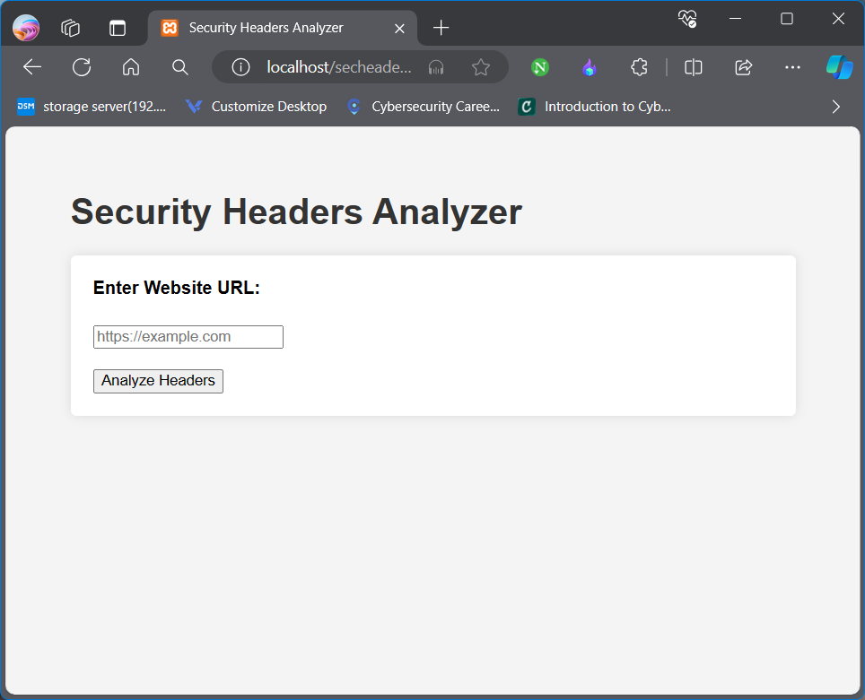
Screenshot:-

Slide 9
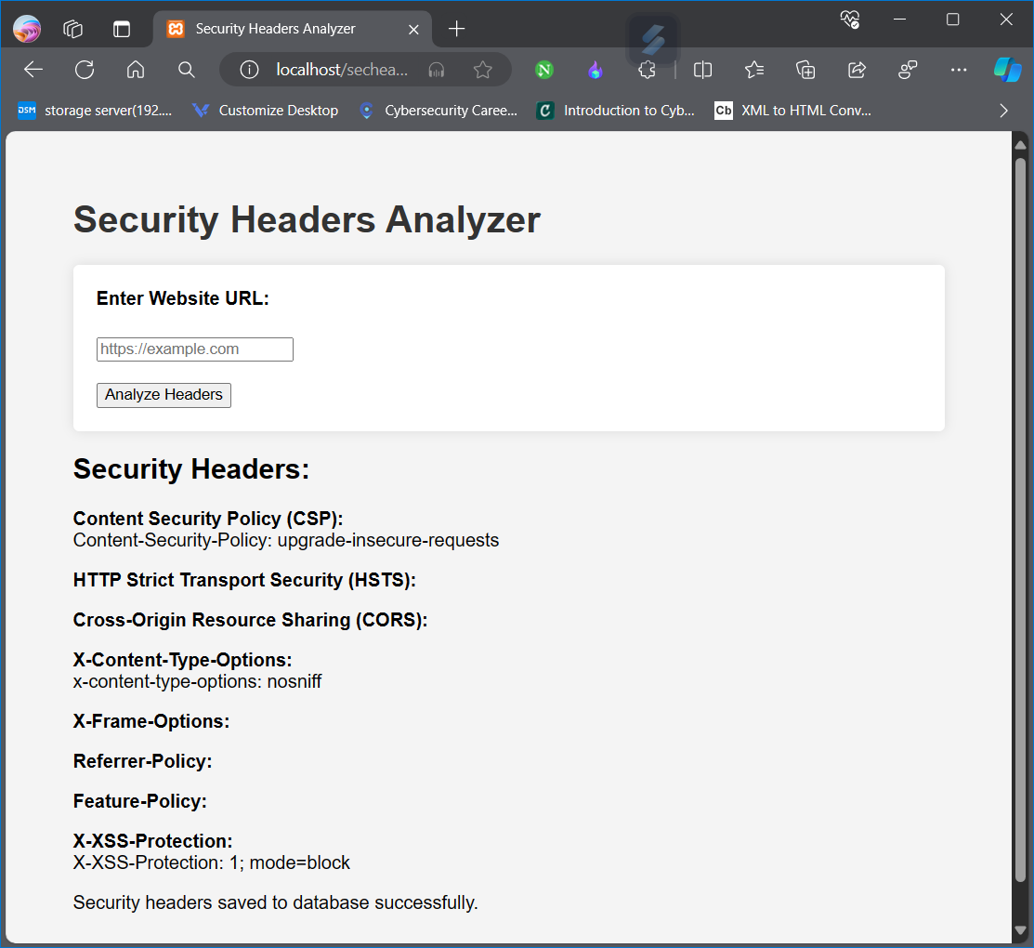

Slide 10
